Slide 1
Scottish Water
Solution

Slide 2
Deal Overview

Slide 3
Support Scope Briefing
Scope
Applications Management, Incident & Problem Management, Change & Release Management, Environment & Configuration Management, License Management, Innovation & Continuous Improvement, Agile, DevOps, and automation-driven enhancements, Strategic reporting and stakeholder engagement, proactive monitoring, self-help enablement, integration services, knowledge management
Enterprise Systems
Aquadvanced
Customer Cloud Service (CCS)
Dynamics CRM
EPM Cloud Planning
Fusion Financials & Payroll
GIS
Lomond Scheme
Open Enterprise
Primavera
Puzzel
Salesforce
Workday
Incident Volumes
Aquadvanced (7)
Customer Cloud Service (CCS) (197)
Dynamics CRM (863)
EPM Cloud Planning (3)
Fusion Financials & Payroll (154)
GIS (59)
Lomond Scheme (9)
Open Enterprise (40)
Primavera (20)
Puzzel (42)
Salesforce (528)
Workday (15)
Key skills (technology)
CRM: Dynamics; Field Service Management, Salesforce
Engineering: SCADA< Telemetry
GIS:
Analytics & BI: Power BI, Power apps, Databricks), Azure Data Factory
ITSM: ServiceNow
Coverage and Language
Language Support: English
24x7 on desk

Slide 4
Observation and analysis for enterprise applications
Design Principles and ways of working
People Design
People skills – Techno-functional resources with good process knowledge of utilities focussed on Finance, HR, CRM, Engineering, Field Service Management
Agile, DevOps ways of working
Cross Training for specific skills for monitoring, Self-service, L1.5 smart operations through SOP based resolution capabilities
Problem Management team focus on top contributing apps – Dynamics, Field Service Management, CCS, FAB, GIS, Microsoft 365, Puzzel, Open Enterprise
Knowledge management and self-help
Criticality | Business and operationally critical | Key Service Areas & deliverables | Frontline support hub Rapid resolution, root cause analysis, and prevention. Safe, efficient delivery with zero tolerance for failures. Secure, compliant, and automated. License Management, compliance Innovation & Continuous Improvement Ways of working: Agile, DevOps, and automation-driven enhancements.
Hosting | Cloud (9) On-premise (3) | AIOps, Autoation and GenAI | Proactive monitoring, self-help enablement, and incident prevention, Zero Preventable Incidents
Key Functional Areas | Finance, HR, CRM, Engineering, Field Service Management | Enable Collaboration | SIAM Application lifecycle management Program Governance, DevOps, and innovation. Device monitoring Intune support, Tech Bar, and lifecycle management. Data governance, privacy, and regulatory compliance.
Model Design
Support teams aligned by functional capabilities for greater autonomy and speed to value realization
Capability Building – Cross skilled resources trained in Functions, Technical, ITIL and Automation
CICD pipeline
Tools/Scripts for proactive diagnostics to ensure reliability
Focus on Observability , Automation, Self Service enablement
Location/shift Design
Dedicated Onsite personnel in Scotland for business interactions and critical incidents
24*7 support
The 12 enterprise systems are operationally critical applications. Need 24x7 coverage, high focus, and high availability
Availability target: 99.8% for critical business processes
Performance parameters:
•Defined response and resolution times.
•Focus on Zero Preventable Incidents.
AI-powered self-help via ServiceNow.
Continuous improvement of knowledge base

Slide 5
Our Solution theme aligned to Scottish Water’s goals

Slide 6
Our key building solution blocks for Scottish Water Based on Analysis and inferences we infused Solution themes with our NextGen AMS to enhance CloudOps experiences to operations, business and IT stake holders
Potential Outcomes*
Ensure Reliable & Secure
Operations
Integrated Operating Model for resilience and agility
AI Infused SMART Operations:
L1.5 for SOP based operations
Dedicated Automation POD
Digital & Process Command Center
Stability
99.99% Availability
~30% Tech Debt Reduction
Extreme Efficiency
01
Productivity
42% Productivity Improvement
~20% Ticket reduction
Ways of Working: Functional Aligned
Mature and Reduction of Technical Debt
Maturing DevSecOps & AI / Gen AI Product Lifecycle
Product Engineering and
Service Delivery & Governance
High performing digital services
02
Accelerate Value
Creation
Experience
>45% Same day resolution
>40% FCR Improvement
>30% MTTR Improvement
Agility
15% Velocity improvement
20% Release improvement
30% Regression Test Automation
Service Excellence
03
Quality &
Experience
IT Stakeholder Experience
End User Experience
Business Experience
* Potential outcomes are indicative. Wipro will evaluate and assess based on the current usage, maturity and adoption of the newly implemented application and application landscape

Slide 7
Our Cloud Operations Focus Areas for Enterprise Apps
Automation / Infra as Code
Integrated Monitoring
Service Onboarding
1
2
3
Automated version control, deployments
Environment provisioning, deprovisioning
Auto-scale-in, scale out
Event alerts, transaction log alerts
Log analytics
Resource utilization (Compute, Storage, Network)
Availability & Performance Metrics, Dashboards for Single Pane of Glass
Service Catalogue, Blueprints
Approval workflows for app onboarding
Multi Cloud blueprints
Multitier app deployment blueprints
Multitier infrastructure deployments
Security Services
Service Consumption
Service Operations
5
6
4
OS, DB Patch Management
Certificate, PKI Management
VPC, DNS, Network Management
DB, Middleware and Integration admin
Storage tracking, monitoring
Continuous rightsizing
Asset management registration, de-registration
Platform security policies
Security vulnerabilities remediation and RCA
IT Policy Management
Role Based Access Control (RBAC)
Identity & Access Management
Security and Compliance Dashboards
Multi-cloud governance
Capacity planning & management
Consumption Analysis, Forecasting, Trend Analysis
Billing reports (LOBs, region, app wise etc.)
Chargeback to LOBs, cost centers
License management
Asset optimization recommendations
Foundational Services (one-time) – CI/CT/CD pipeline setup, Monitoring tools setup, SSO integration, API integration with tools, Multi-cloud integration

Slide 8
Our Target Operating Model
To be updated
Key principles:

Slide 9
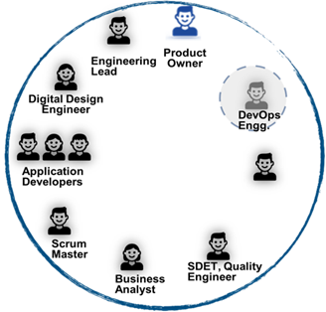
We will realise our solution tenets by bringing modern CloudOps operations practices and principles in 2-stage shift approach
1- 8 months
From month 8
Scottish Water Business & IT Users
Scottish Water Business & IT Users
Digital Experience Centre (DEC)
Digital Experience Centre (DEC)
Smart Operations
Integrated Monitoring of apps, platforms and compute for Single Pane of Glass
Infra as Code (Auto Cloud stack provisioning, deployments, scaling)
Adoption of SRE practices for platform availability, resiliency, manage SLOs, SLIs
Vertically integrated full-stack model
Business led, vertically integrated delivery model aligned by functions
Automated DevSecOps pipeline
Design, Build, Test and Release in continuous delivery mode
Single product backlog for fixes, features and upgrades
Security and Platform operations (DB, MW, Integrations) integrated into pipeline across Cloud & DevSecOps
Program Governance
Program Governance
Service Integration & Management
Service Integration & Management
Finance
CRM
HR…
Finance
CRM
HR…
L1.5, Automated and SRE operations
(Integrated Monitoring, AIOps, Infra as Code for Auto Provisioning, Deployment)
L1.5 Operations & Automation
(App Monitoring, Task Automation)
Application Support (L2 & L3), Minor Enhancements
PODs
PODs
PODs
Application Development, Changes
Horizontal services – Database, Middleware, Integrations, Security
Infra Support – Servers, Storage, Network, Infra Monitoring
Cloud Service Provider – Compute, Storage, DB, Backup, VPC

Slide 10
Our integrated operating model is designed for efficiency, resilience and agility
Governance,
Program Roadmap,
Analysis, Biz stakeholder management
Scottish Water Business & IT Users
Key interventions
Program Governance*
Digital Experience Centre (DEC)
1. Integrated Program Governance
Strong governance & advisory team as Wipro investment comprising of Program governance capabilities, Payor Domain SME, who will work closely with stakeholders within Scottish water Health
2. Smart Ops
Wipro Digital command Centre – L1.5 driving shift-left, AIOPs enabled full-stack observability
Dedicated Automation PODs – automation assets creation, Industrialization of Operations through RPA BOTs / AI assist
3. Build Ops
Wipro SRE Ops team focus on reliability Engineering and identify prioritization criteria (tickets vs enhancements)
Wipro Techno-functional L2/L3 teams working on ‘unified backlog’ for incidents, SRs and enhancement requests
Utilize SRE teams and Prioritization Matrix for effective prioritization.
Gen-AI assisted development for Productivity improvement across SDLC lifecycle
4. Platform Services
Leverage tools & technology accelerators to scale platform capabilities
Seamless Operation leveraging the Differentiated Foundation Platform services
Robust Threat, Vulnerability Management, Security services
5. Enablers
Joint Innovation Council to drive Industry through leadership and Continuous improvements
Technology CoEs and Innovation Labs to drive tech alignment
Wipro-Scottish water Academy to groom and train talent on Future-ready digital skills
Intercept & Push, Self-Heal, Catalogue, Self-help, Workflows, Operational Analytics
Digital & Process Command Center, L1.5, SOP Tasks,
Automation PODs- AIOps, Chat Ops, Digital Colleagues
Cross IT/Functional
Services – ITSM, Lean Processes
Finance
HR
CRM
Engineering
Field service management
L2 + L3
L2 + L3
L2 + L3
L2 + L3
L2 + L3
Quality Engineering (Automation + Manual)
Enterprise Integration (Boomi, Azure integration)
Major Projects
Platform Services – Azure DevOps, Application Security & Vulnerability
Enterprise Capabilities : QE (TC4E ) | DevSecOps | Gen AI
Scottish Water Academy
Center of Excellence(s)
Lab 45 | Oracle | Automation | Engineering | Cloud | AI | Analytics …
Partnership & Ventures
Oracle | Salesforce | Azure | Workday
HR | Talent
* Collaborative governance between Scottish Water & Wipro
Scottish Water managed Service desk

Slide 11
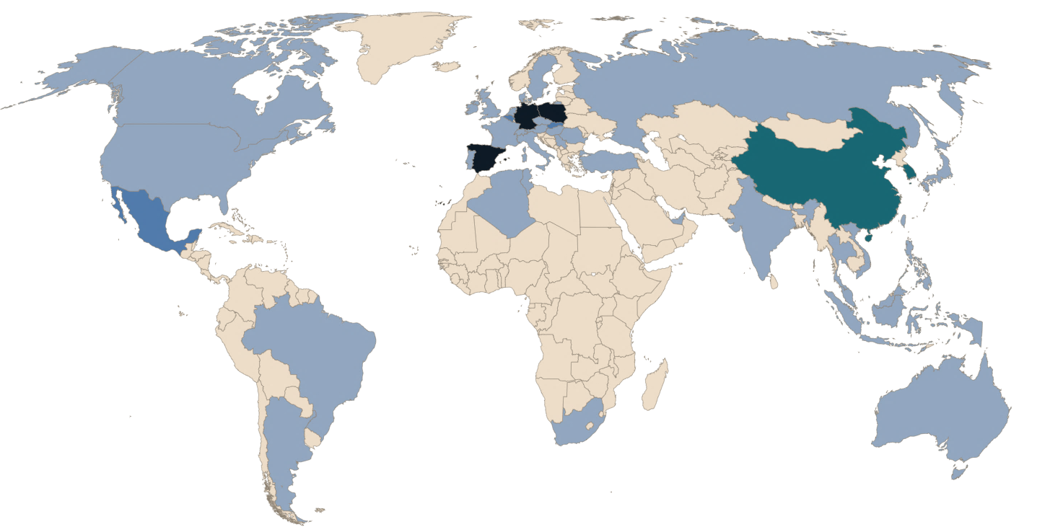
Delivery Locations
Scotland
Locations
Services
India
Locations
Services

Slide 12
Monitoring + Observability + AI
Our Monitoring Approach
24x7 proactive monitoring of applications, platforms, and integrations
Leverage Azure Monitor, App Insights, and Log Analytics for real-time insights
Continuous health checks and predictive alerting for critical services
Integration with ServiceNow for incident automation and resolution tracking
Full-Stack Observability
End-to-end telemetry across application, infrastructure, and network layers
Dashboards with availability, performance, and SLA/SLO metrics
Seamless observability across hybrid environments (Azure, SaaS, On-prem)
Root cause analysis supported by event correlation and trend mapping
AI-Driven Operations (AIOps)
AI models within ServiceNow and Azure Sentinel for:
Incident auto-categorization
Predictive failure detection
Anomaly detection and root cause prediction
NexThink & Intune Analytics leveraged for proactive endpoint issue resolution
Enable self-healing workflows and dynamic knowledge base updates

Slide 13
DEC Services

Slide 14
Service Desk Services
Scottish Water Outcomes
Scope
Volumetrics
Strategic Objectives
Enhance productivity and efficiency through innovation, automation and AI
Improve decision-making through data-driven insights
Empower and enable our people and partners to be more effective
Safeguard and protect our business and customers from cyber threats
Lot 2 - Digital Experience Centre, Service Outcomes – Key Differentiators
Proactive Preventative Maintenance & Monitoring
Zero Preventable Incidents
Business Contextualisation
Ticket Management / Knowledge Management / AI
Customer Experience
Solution Considerations/Assumptions
Tools/Accelerators (SW and Wipro)

Slide 15
How?
Zero Preventable Incidents
DCEM targets
Customer Experience
Proactive Preventative Maintenance & Monitoring
Business Contextualisation
Ticket Management / Knowledge Management / AI

Slide 16
ServiceNow (+ AI)

Slide 17
Assumptions and Clarifications from Scottish Water
Assumptions
***************
Clarification questions
*********************

Slide 18
Enterprise Applications

Slide 19
Enterprise Applications
Scottish Water Outcomes
Scope
Volumetrics
Strategic Objectives
Enhance productivity and efficiency through innovation, automation and AI
Improve decision-making through data-driven insights
Empower and enable our people and partners to be more effective
Safeguard and protect our business and customers from cyber threats
Enterprise applications, Service Outcomes – Key Differentiators
SLOs
Zero Preventable Incidents
Continuous Improvement/Innovation
Solution Considerations/Assumptions
Tools/Accelerators (SW and Wipro)

Slide 20
How?
Zero Preventable Incidents
DCEM targets
SLOs

Slide 21
Assumptions and Clarifications from Scottish Water
Assumptions
***************
Clarification questions
*********************

Slide 22
Azure Cloud Platform/ Data Platform/ Microsoft 365

Slide 23
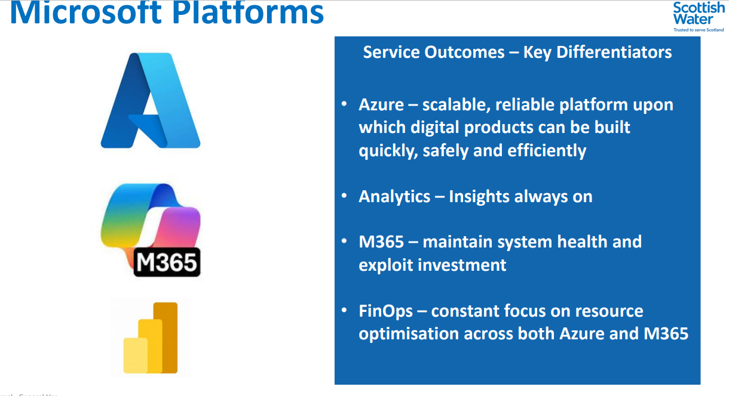
Azure Cloud Platform
Draft to be reviewed with practice
Scottish Water Outcomes
Scope
Volumetrics
Objectives
Provide a scalable, secure, and resilient cloud foundation for business-critical and line-of-business applications.
Enable DevSecOps and Infrastructure-as-Code (IaC) practices for agility and governance.
Ensure high service availability and platform evergreen compliance (e.g., patching, vulnerability mgmt.).
Implement FinOps visibility and optimization controls to manage cloud costs and usage.
Outcomes:
Scalability Auto-scaling infrastructure and apps respond to business demand changes.
Reliability 99.9%+ uptime; resilient architectures with proactive failover mechanisms.
Security & Compliance NIS, Zero Trust enforcement, and conditional access policies are applied.
Cost Optimization Rightsized resources and policy-based shutdowns reduce wastage.
Observability Unified alerting (via Monitor, Sentinel) drives ZPI and proactive ops.
Support for the Azure platform & applications hosted on Azure, Azure iPaaS-based integration layers, automation scripts, and APIs.
Management & Automation of Azure cloud resources, services and components, including IaaS, PaaS, iPaaS & automation accounts, and monitoring solution.
Evergreening of deployed infrastructure & all other associated Azure Services & component.
Secure design aligned to Zero Trust & NIS compliance.
Collaboration with engineering/OT environments
> 6,000 proactive support alerts/year (a large % tied to Azure workloads).
~160–180 Build Defects per month relate to cloud-hosted integrations.
24×7 support required for production-critical Azure services.
Solution Considerations/Assumptions
Tools/Accelerators (SW and Wipro)
Azure is the primary cloud platform for Scottish Water (ref: Digital Directorate section).
All changes, alerts, and health data must flow through ServiceNow.
Requires integration with tools like Sentinel, App Insights, Azure Monitor.
Assumes subscription-level visibility for partner-managed services.
CI/CD pipelines expected to follow DevSecOps and GitOps best practices.
Azure Monitor (alerting, telemetry, proactive threshold setting).
App Insights (application-level observability).
Azure Sentinel (security event correlation).
ARM templates / Bicep / PowerShell / Terraform for provisioning & automation
Azure DevOps for deployment automation
Accelerators for RCA, cost optimization, and auto-remediation workflows.

Slide 24
Data Cloud Platform (Azure + Power BI)
Draft to be reviewed with practice
Scottish Water Outcomes
Scope
Volumetrics
Objectives
Deliver a governed, secure, and unified analytics ecosystem using Azure Lakehouse, Synapse, and Power BI.
Enable data availability 24x7 for critical business operations, regulatory, and OT intelligence.
Support DataOps and automated pipeline monitoring to prevent data failures and improve trust.
Improve insight consumption and business decisioning through scalable dashboarding.
Outcomes
Pipeline Reliability Data refresh jobs monitored and recovered automatically via alerts.
Insight Timeliness Reports/dashboards delivered with SLA-defined freshness targets.
Semantic Layer Performance Fast queries and optimized visuals for decision-makers.
Governance & Lineage Data is catalogued, lineage mapped, and compliant with data policies.
User Empowerment Business users create and consume secure Power BI insights with confidence.
Management and enhancement of the Azure Lakehouse, Data Factory, Power BI, and Synapse services.
Ownership of data ingestion, pipeline health, orchestration, semantic layer performance.
Service support for analytical models, ML/AI integrations, and dashboards.
Ensure data governance, privacy compliance, and data cataloguing.
Data platform drives part of the Application Errors (~15–20%).
~10–15 Monthly ME/NDRs mapped to Data Engineering / Reporting enhancements.
24×7 support expected for data pipelines feeding critical reporting.
Solution Considerations/Assumptions
Tools/Accelerators (SW and Wipro)
Power BI is tightly integrated into enterprise workflows.
SW’s data products span structured + unstructured sources.
The solution must support both L1 triage and L3 deep data model support.
Requires DataOps-style Dev/Test/Data Quality frameworks.
Azure Data Factory / Synapse Pipelines for orchestration.
Azure Lakehouse (Delta Lake / LakeDB) for unified analytics.
Power BI + Power BI Gateway support packs.
Purview / Unity Catalogue (if integrated) for metadata lineage.
In-house accelerators: data validation templates, pipeline health dashboards, alert correlation scripts.

Slide 25
Microsoft 365
Draft to be reviewed with practice
Tahir: Updated completely
Scottish Water Outcomes
Scope
Volumetrics
Objectives:
Modernize and streamline collaboration across the organization using Microsoft 365 tools.
Enable secure, scalable, and governed usage of M365 services including SharePoint, Teams, OneDrive, and Power Platform.
Drive adoption and productivity through tools like Copilot, Power BI, and Power Apps.
Ensure resilient and proactive support for M365 services with 24x7 coverage and alignment to performance measures.
Empower users with self-service and automation via ServiceNow integration and knowledge management.
Maintain compliance and governance across identity, access, data protection, and licensing.
Outcomes:
High service availability and performance for all M365 services (target: 99.8% uptime).
Improved user satisfaction measured via Digital Customer Experience Measure (DCEM) and Happy Signals.
Reduced incident volumes through proactive monitoring, automation, and first-time fixes.
Effective governance and lifecycle management of apps, data, and environments.
Accelerated adoption of Copilot and Power Platform with enablement, training, and support.
Seamless integration with internal teams (SIAM, PRS, Cloud CoE) and other vendors.
Core Services:
SharePoint, OneDrive, Outlook, Teams: Admin configuration, incident resolution, governance, and user support.
Intune: Policy management, device lifecycle support, and escalation handling.
Power Platform: Governance, app inventory, break/fix support, and enablement.
Power Apps, Power Automate, Power BI: Support for custom apps, flows, dashboards, and integrations.
Copilot: Use case enablement, adoption support, and troubleshooting.
Office Suite (Excel, Word, PowerPoint, etc.): Break/fix, compatibility, and user queries.
Users: ~6,100 (including partners/supply chain)
Devices:
Laptops: 4,920
Tablets: 1,206
Mobile Phones: 3,161
Microsoft 365 Licenses: E5 (with Copilot for ~2,000 users)
Power BI Reports: 4,334
Applications: 1 for SharePoint & 33 for SharePoint
Support Hours: 24x7 for critical services; 9am–5pm for others
Support Channels: Phone, email, Teams, self-service, outbound
Tools Used: ServiceNow, Intune, NexThink, Azure Monitor
Solution Considerations/Assumptions
Tools/Accelerators (SW and Wipro)
Strategic Fit: Align Microsoft 365 services with Scottish Water’s digital transformation goals, user experience metrics, and sustainability objectives.
Operating Model: Implement a federated, 24x7 support model integrated with ServiceNow and internal teams to ensure seamless service delivery.
Team & Skills: Deploy specialized M365 experts across collaboration, security, and automation domains to meet diverse support needs.
Volumetrics-Based Planning: Design support capacity based on user count, app inventory, and ticket patterns to ensure scalability.
Innovation & Improvement: Continuously enhance service through automation, Copilot adoption, and proactive analytics aligned with business goals.
Knowledge & Reporting: Enables self-service and transparency through a dynamic knowledge base and SLA-driven performance reporting.
TOOLS & PLATFORMS:
Microsoft Service Health Dashboard
Microsoft Intune & Endpoint Manager
Microsoft 365 Admin Center
Power Platform Admin Center
ServiceNow ITSM
NexThink
Azure Monitor & Log Analytics
Microsoft Copilot Studio
ACCELERATORS:
M365 Adoption Toolkit
Copilot Use Case Library
Power Platform Center of Excellence (CoE) Starter Kit
Self-Service Portals (via Power Apps): Automate common requests like access, password reset, and app usage.
First Time Fix Knowledge Base
License Optimization Dashboards

Slide 26
How?
Draft to be reviewed with practice
Zero Preventable Incidents (ZPI)
Digital Customer Experience Measure (DCEM)
Cloud Financial Operations (FinOps)
What is it? A strategic target where no incident should occur if it could have been predicted, detected, or prevented with monitoring, testing, governance, or change control.
What is it? A multi-metric performance index used by Scottish Water to quantify the end-user digital experience. It focuses on sentiment, system usability, performance, and resolution effectiveness.
What is it? FinOps is the practice of managing cloud cost, usage, and value — especially in Azure and data platforms. It’s about balancing cost control with speed and value delivery.
How ZPI Works in Practice?
What makes up DCEM?
FinOps Principles
Practice Area | Contribution to ZPI
Monitoring & AIOps | Detect anomalies before failures (e.g. CPU spike alerts)
Automated Testing | Prevent code regressions or config drift
Change Control | Prevent incidents from poorly tested deployments
Knowledge Mgmt | Avoid “known error” tickets recurring
Proactive Service Desk | Resolve before user impact (via NexThink or Intune)
RCA Loop | Root cause analysis closes the loop on repeat issues
Pillar | Example Metric
Self-Service Success | % issues resolved via portal or chatbot
Communication Quality | # of chase calls / % updates sent proactively
Time-to-Resolution | Median time to close incident
First Contact Resolution | % resolved on first touch
Sentiment/Survey | CSAT/Net Promoter Score after ticket close
Knowledge Utilization | % of tickets deflected via KB use
Practice Area | Contribution to ZPI
Cost Visibility | Understand costs by resource, app, owner
Optimization | Rightsizing, removing idle resources
Forecasting | Monthly usage patterns → project cost trends
Accountability | Showback/Chargeback per team or app
Policy Enforcement | Resource tagging, budget alerts, quota limits
Cost Visibility | Understand costs by resource, app, owner
Azure FinOps Tools
Azure Cost Management + Billing
Budgets, Alerts, Reservations
Workbooks for chargeback modelling
Azure Policy / Tagging Compliance
Kusto Queries to track spend spikes
KPI | Description | Target*
% Repeat Incidents per App | Number of recurring issues | < 2%
% Avoidable Incidents | Based on RCA flag | 0 (long term)
Time to Implement RCA Fix | How quickly a root cause fix is deployed | < 5 working days
% Issues Resolved Proactively | Closed before end-user complaint | > 40%
ZPI KPI Examples
DCEM > ZPI Strategy
A ZPI culture drives DCEM improvements — when issues are prevented, user experience improves.
Automated insights from NexThink + ServiceNow feed both ZPI and DCEM tracking.
Chase calls (a DCEM detractor) often point to avoidable miscommunications — fixable under ZPI.
FinOps Lever Impact on ZPI & DCEM
Auto-shutdown policies Avoid unplanned outages or noisy neighbor issues (ZPI)
Rightsizing compute Improve app responsiveness (DCEM)
Proactive budget alerts Avoid resource cut-off impacting service users.
Monitoring high-cost growth Catch runaway processes linked to defects

Slide 27
How?
Draft to be reviewed with practice
Tahir: Reviewed and updated
Azure
Capability | How It Ensures Scalability & Reliability
Auto-scaling & Load Distribution | Azure App Services, ACA, AKS, VMSS & Functions scale dynamically on load
Infrastructure-as-Code (IaC) | Repeatable, version-controlled deployments (Terraform/Bicep)
Multi-region Architecture & DR | Geo-redundancy with active/passive or active/active configurations with availability zone / availability set
App Insights & Azure Monitor | Proactive issue detection, dependency mapping, SLAs tracking
Zero Trust & Policy Compliance | Platform hardening, conditional access, tagging and audit policies
Azure Blueprints / Landing Zones | Governed onboarding of new services
FinOps Practices | Right-sizing, cost visibility, quota alerts
Strategy:
We design and operate Azure-hosted services using resilience patterns, automation, and FinOps principles to ensure that the platform scales seamlessly, is cost-optimized, and remains highly available for all line-of-business and digital apps.
Outcomes: Zero business disruption from platform events (ZPI); Self-healing infrastructure and alerts; Predictable, repeatable platform scaling for data & apps; Hardened compliance to NIS & ISO27001
Analytics
Capability | How It Enables Always-On Insights
Lakehouse Architecture | Unified source for raw, curated, and semantic layers
Data Factory + Synapse Pipelines | Orchestrate batch + near real-time ingestion (error-handled)
Power BI Premium Capacity Management | Ensures performance, caching, and refresh optimisation
Monitoring & Alerting | Detect failed jobs, refresh delays, permission issues
Purview / Catalogs | Trace data lineage, control data ownership
DataOps Practices | Versioning, testing, governance for analytics pipelines
Always-On SLA Monitoring | Use Kusto queries + Workbooks for latency and freshness tracking
Strategy:
We manage Scottish Water’s Azure-based Data Lakehouse, Synapse, Power BI, and ADF pipelines as a continuous, resilient, and governed ecosystem — designed for 24/7 analytical availability and insight generation.
Outcomes: Reliable delivery of dashboards and reports (e.g. regulatory, OT, asset data), No refresh failures or broken visuals in Power BI, Predictive alerting for ingestion pipeline failures, Improved trust in data, insight-led business decisions
Microsoft 365
Capability | How It Maintains Health & Drives ROI
M365 Admin Center + Intune Monitoring | Track sync issues, patch compliance, license status
Proactive Ticket Prevention (NexThink) | Detect endpoint issues before user complaints
Power Platform Governance | Enforce DLP, environment guardrails, app lifecycle
Viva Insights | Drive adoption and user wellness visibility
Self-service Enablement via Employee Center | Reduces request volume, boosts experience
M365 Change Awareness | Integrate Microsoft release roadmap into service readiness
Security & Compliance Dashboards | Track access, sharing, shadow IT, and regulatory compliance
Strategy: Our strategy is to deliver a resilient, user-centric Microsoft 365 support model that aligns with Scottish Water’s digital transformation goals by combining specialized expertise, automation, and proactive service management.
We will implement a federated operating model integrated with ServiceNow and internal teams, enabling seamless collaboration, governance, and 24x7 support across all M365 workloads.
Outcomes: Reduction in M365 “How-to” and password-related incidents, Better alignment of M365 use to employee roles & personas, Monitoring-driven performance and security compliance, Increased adoption of Power Automate, SharePoint, Teams

Slide 28
Assumptions and Clarifications from Scottish Water
Assumptions
***************
Clarification questions
*********************
To be updated

Slide 29
Clarifications required from Scottish Water for Microsoft 365 Service
SharePoint:
Can you please specify details of the current SharePoint landscape (number of sites, site types, storage usage, customizations, and integrations) that needs to be supported?
Are there any legacy SharePoint environments (on-premises or classic sites) still in use or planned for migration? Is these also part of the current scope for support?
OneDrive:
How many users actively use OneDrive, and what is the average storage consumption per user?
Outlook:
What is the current mail platform (Exchange Online only, or hybrid/on-premises)?
Are there any custom mail routing, journaling, or compliance archiving requirements?
Teams:
How many Teams users, and what is the breakdown of usage (chat, meetings, telephony, apps)?
Is Teams telephony (PSTN) in scope? If so, what is the current call volume and support model?
Are there any custom Teams apps, bots, or integrations in use?
Power Platform:
How many Power Platform environments are in use, and what is the governance model (managed vs. unmanaged environments)?
Power Apps:
How many custom Power Apps are in production, and what is their criticality?
Are there any complex model-driven or canvas apps with integrations to on-premises data?
Are there any citizen developer enablement or support expectations?
Power Automate:
How many flows are in production, and what is the average volume of runs per day?
Are there business-critical or high-volume flows that require proactive monitoring?
Are there any custom connectors or premium connectors in use?
Power Automate Desktop:
How many desktop flows are in use, and what is the support model for RPA bots?
Are there any unattended RPA scenarios or integrations with legacy systems?
What is the expected volume of break/fix or enhancement requests for desktop automations?
Copilot:
Can you specify the use cases where Copilot is being leveraged?
What is your future roadmap for the next 2-3 years for Copilot and Are there plans to expand Copilot usage or integrate with custom business data?
Are there any restrictions or governance policies for Copilot usage (e.g., data boundaries, privacy)?
What is the expected support model for Copilot (user enablement, troubleshooting, adoption analytics)?
Overall Microsoft 365:
Can you please specify the monthly minor enhancement capacity for SharePoint and Power Platform that may be required as part of the Microsoft 365 services?
Can you please specify the different monitoring and reporting tools that are being leveraged in the current support model?
Can you please specify the if you have implemented any specific automation interventions for supporting Microsoft 365 services?

Slide 30
SR27

Slide 31
Clarifications required from Scottish Water for Microsoft .NET
.NET :
How many .NET applications are in use ?
What are the CORE technologies used in .NET application
List down application modernization is scope for .NET application ie Target state to Source state
What are the monitoring tools used in .NET applications
Please share any volumetric data available for .NET applications
No of user base for all these .NET application
What is the backend used in Scottish water and list down any transformation or AMS is required
Are these .NET applications are web or windows based
What are the external and internal interfaces

Slide 32
SR 27
Scottish Water Outcomes
Solution
SR 27 operating model objectives
Better business outcomes at lower cost and carbon
Adaptive and more agile model – product orientated
New capabilities in Digital engineering and AI
Accelerates us towards our Strategic Ambitions

Slide 33
Projects

Slide 34
Projects
Draft to be reviewed with practice
Scottish Water Outcomes
Solution Tenets
Objectives
Strategic Delivery: Deliver discrete, outcome-focused projects aligned with Scottish Water’s digital priorities.
Agile and Predictable Execution: Apply Agile and/or PRINCE2 disciplines to deliver value early and often.
Robust Governance: Operate within a gated model (G30-G110) with measurable project health at each stage.
Business Value Realization: Align each initiative to clear business benefits and outcomes (IPOD, IFAC measures).
Right-Sized Planning & Estimation: Build accurate resource/cost/benefit forecasts at initiation phase.
Compliance & Risk Awareness: Deliver secure, NIS-aligned, financially auditable projects.
Capacity Enablement: Augment Scottish Water capabilities via skilled professionals in hybrid teams.
Outcomes
High-quality, scalable digital solutions: Delivered on time, on budget, per design specs.
Gate-aligned progress and assurance: Gate 30–110 outcomes traceable via progress, cost, and KPI reporting.
Reduced variance and drift: Forecast vs actual metrics monitored; corrective plans initiated if needed.
Knowledge transfer and sustainment: Projects leave documented artefacts and trained teams for BAU transition.
Value Realisation via KPIs: IPOD (delivery), IFAC (costs), PCL (commitments) consistently met or exceeded.
Tenet | Description
Agile + Gated Hybrid Delivery | Use PRINCE2 & MSP-aligned G30–G110 gates with Agile delivery within phases
Delivery Readiness Assurance | Architecture, requirements, and resource readiness embedded in early gates
Fusion Team Model | Blended teams of SW, partner, and niche SMEs enable knowledge & control
Outcomes-Driven Business Cases | Every project includes impact, cost-benefit, and risk-adjusted justification
Design for Operability | Every project must plan for ZPI, supportability, and evergreen operation
Digital Twin + Integration Ready | Projects consider OT/IT convergence, system interoperability
Secure by Design | All solutions must meet Scottish Water’s cyber, data, and compliance standards
Key Considerations
Area | Consideration
Governance | Gate-based checkpoints (G30 to G110), IPOD/IFAC used for outcomes tracking
Tooling & Traceability | ADO, SharePoint, ServiceNow used for traceability, artefact storage, reporting
People & Skills | Project teams must scale as needed with specialist access on-demand
Documentation & Handover | All project artefacts: HLDs, LLDs, test scripts, training material, SOPs
Knowledge Transfer | Structured KT before BAU transition; support for DEC & app teams
Risk & Issue Management | Risk exposure and mitigation updated at every gate, aligned with Unifier logs
Commercial Control | Forecast-to-actual tracked monthly; variances justified and corrected
Security & Resilience | All implementations comply with Zero Trust, cyber, DR, HA expectations
Project Performance Measurement Framework
Measure | Purpose | Aligned KPIs
PCL | % of projects reaching G90 on time and on budget | G30–G90 success
IPOD | Delivery completion as per baseline scope | G90–G110
IFAC | Budget outturns vs forecasted committed costs | Cost adherence
Milestone Drift | Actual vs planned dates for critical gates/milestones | Gate slippage
Risk Exposure | Quantified residual risk across active project portfolio | Risk log, Unifier
Customer Satisfaction | Quality perception via stakeholder survey or DCEM inputs | Post-G100

Slide 35
Appendix

Slide 36
LIMS APPLICATION MIGRATION

Slide 37
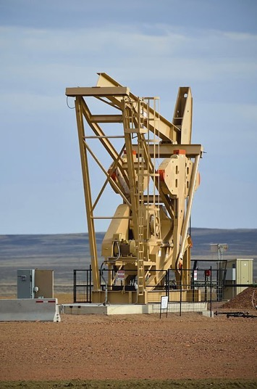
LIMS Migration on-premise LIMS Applications to a cloud computing model Infrastructure as a Service (IaaS)
The Client
Benefits
Thames Water, UK
National Grid, UK
Fortum, Finland
Automation solution for lab end users
Formalized process for incidents and requests and quick turn around.
Making LIMS Centralized and making it available24 X 7 through Cluster Manager & NLB
Our Credentials
The Challenge
Maintenance, support upgrade and migration of LabWare LIMS.
Co-ordinate with Vendor and other customer support teams to carry out support functions so that there is potential reduction in cycle time of support calls and saving of costs
Work with Business, QA, Vendor and other customer support teams to perform Change Management and maintain validated status of applications
Required to Improve Services and reduce cost
The Solution
24X7 reliable support (including on-call support during non-business hours) with responsiveness less than 30 minutes
Upgrading of the exiting LIMS System
Transitioning from Labware Thick Client to Web Client.
Making the LIMS available as a web solution
Team of 2 experience LIMS consultants with Techno functional expertise.
Fixing the existing bugs
Supporting the application to address regular incidents and enhancements.
Effective handling of release management to provide faster solutions for changes requested.
Integrates with other IRIS applications and external system such as SAP, ROMSS, data acquisitionand historian systems.
Extensive Knowledge transfer on the application.
37

Slide 38

Global Centralized LIMS Implementation
The Client
Benefits
Europe based global Integrated Energy Major
USA, UK, Europe & Asia
Central global cost optimal LIMS system
Easy maintenance and future proof solution
Standardization across different lubricant sites with minimal site-specific settings
Our Credentials
The Challenge
Define, Design & Implementation of Labware LIMS to provide global centralized LIMS for 13 sites.
Deploy Labware global instance on a cloud.
Integration of Labware LIMS with about 500 lab instruments using Integration Manager.
Integration of Labware LIMS with other applications.
The Solution
Deployed an onsite/offshore team.
Contribution towards solution design and program delivery.
Requirement study and knowledge management from the ground level to build the technical and functional documents.
Deployment of competent resources both onsite / offshore.
38

Slide 39
LIMS MIGRATION
Draft to be reviewed with practice
Scottish Water Outcomes
Scope
Volumetrics
Objectives
Deliver a governed, secure, and unified analytics ecosystem on migration of on-premise to Azure cloud.
Enable data availability 24x7 for critical business operations , regulatory and other activity according to SW.
Preserve and validate historical data .
Ensure user adoption and knowledge.
Ensure the procedure as per SW during migration
Documentaion and trainings.
Outcomes
Pipeline Reliability Data refresh jobs monitored and recovered automatically via alerts.
Insight Timeliness Reports/dashboards delivered with SLA-defined freshness targets.
Successful migration of LIMS Application into cloud.
Improved data integrity and traceabilty.
Operational continuity with minimal downtime during migration .
Migration and Upgrade of Labware LIMS .
Ownership of data ingestion, pipeline health, semantic layer performance.
support after migration and upgradation to monitor the system and resolution for any identified bug/issues.
Ensure data governance, privacy compliance, and data cataloguing.
Data platform drives part of the Application Errors (~15–20%).
~10–15 Monthly ME/NDRs mapped to Data Engineering / Reporting enhancements.
24×7 support expected for data pipelines feeding critical reporting.
Solution Considerations/Assumptions
Tools/Accelerators (SW and Wipro)
Labware LIMS integrated into the external application( ERP,ELN,instruments) based on SW requirments.
Identify the source system, legacy LIMS and manual systems.
Assess source data quality ,structure , and volume.
Network, firewall, and security consideration.
Follow customer's validation methodology.
Role based access control setup.
Develop training plan for different user roles.
Provide SOPs and System documentaion.
Support and maintenance post go-live.
Azure Data Factory / Synapse Pipelines for orchestration.
Azure Lakehouse (Delta Lake / LakeDB) for unified analytics.
Power BI + Power BI Gateway support packs.
Purview / Unity Catalogue (if integrated) for metadata lineage.
In-house accelerators: data validation templates, pipeline health dashboards, alert correlation scripts.

Slide 40
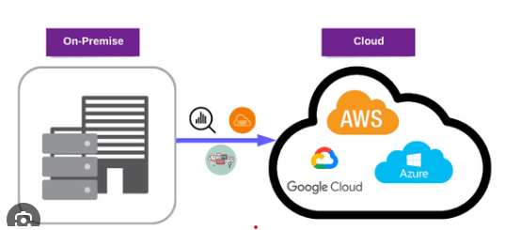
LIMS On-Premise to Cloud Migration
On-Premise to Cloud migration & its Benefits
Benefit | Key Features
Operational | Scalability ,Reliability, Disaster Recovery.
Financial | Reduced IT costs
Security | Advanced protection,compliance.
Agility | Faster deployments,innovation support
Management | Centralized tools,automation,analytics.

